Slide 1
Evo research

Slide 2
Week of Feb 21
Issue:
Not obvious change between no adversary & 1 adversary
Potential solutions
- initialization parameters
- try different cases of initial condition
- squares?
- half of them are adversary?

Slide 3
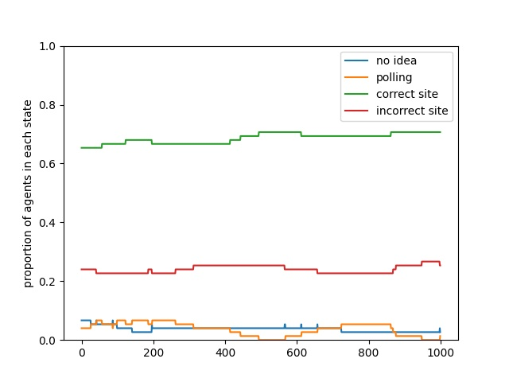
1 adv

Slide 4
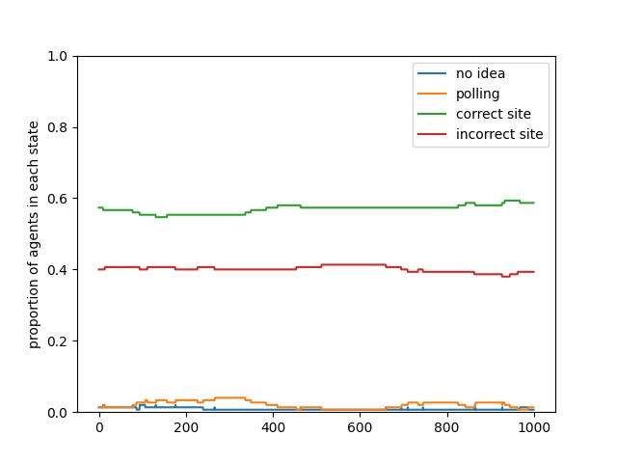
5/15 adversary

Slide 5
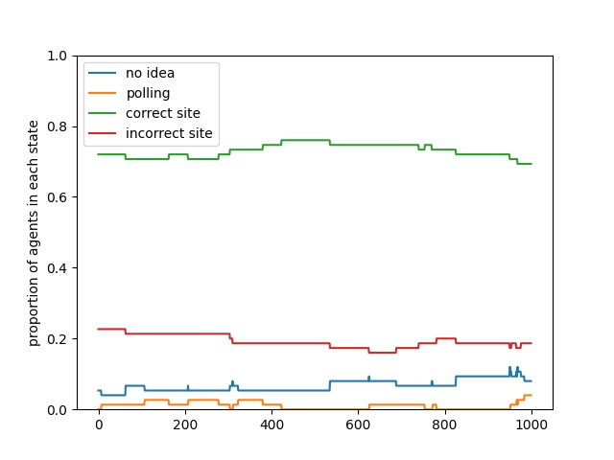
No adv

Slide 6
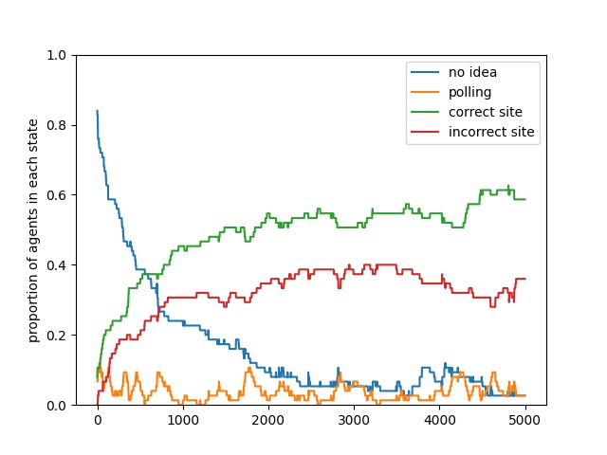
No adv, rand init

Slide 7
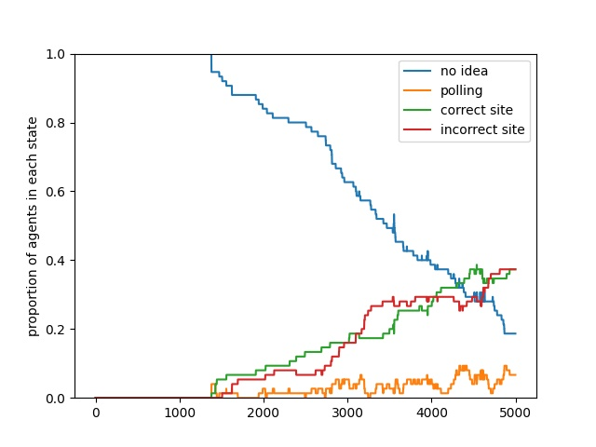
Corner initialization

Slide 8
March 11
Todo: get x-y mutation
New ideas to explore:
Mutation in one chromosome (haplotype stuff)
Horizontal gene transfer in bacteria w 2 strains trying to spread
2 mutations -> triallelic SNPs

Slide 9
Todos
Map -1 to 1 run 1 sim fitness landscape

Slide 10
Faulty ones: sample q , send out q’ = 1 - q
C
For non-faulty ones, when hear q’, reconstruct q = c * q’
For c to become -1

Slide 11
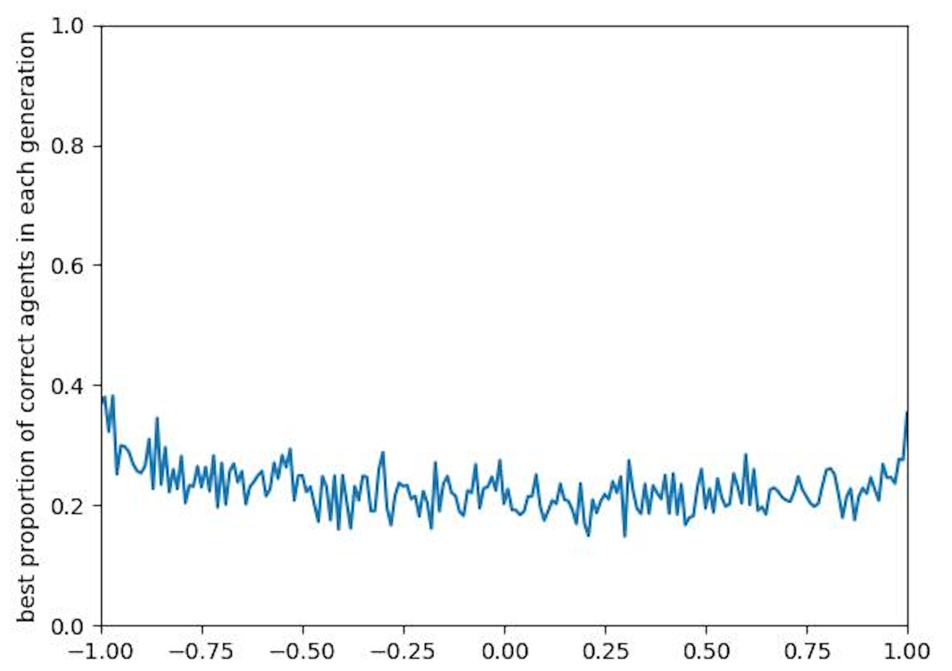
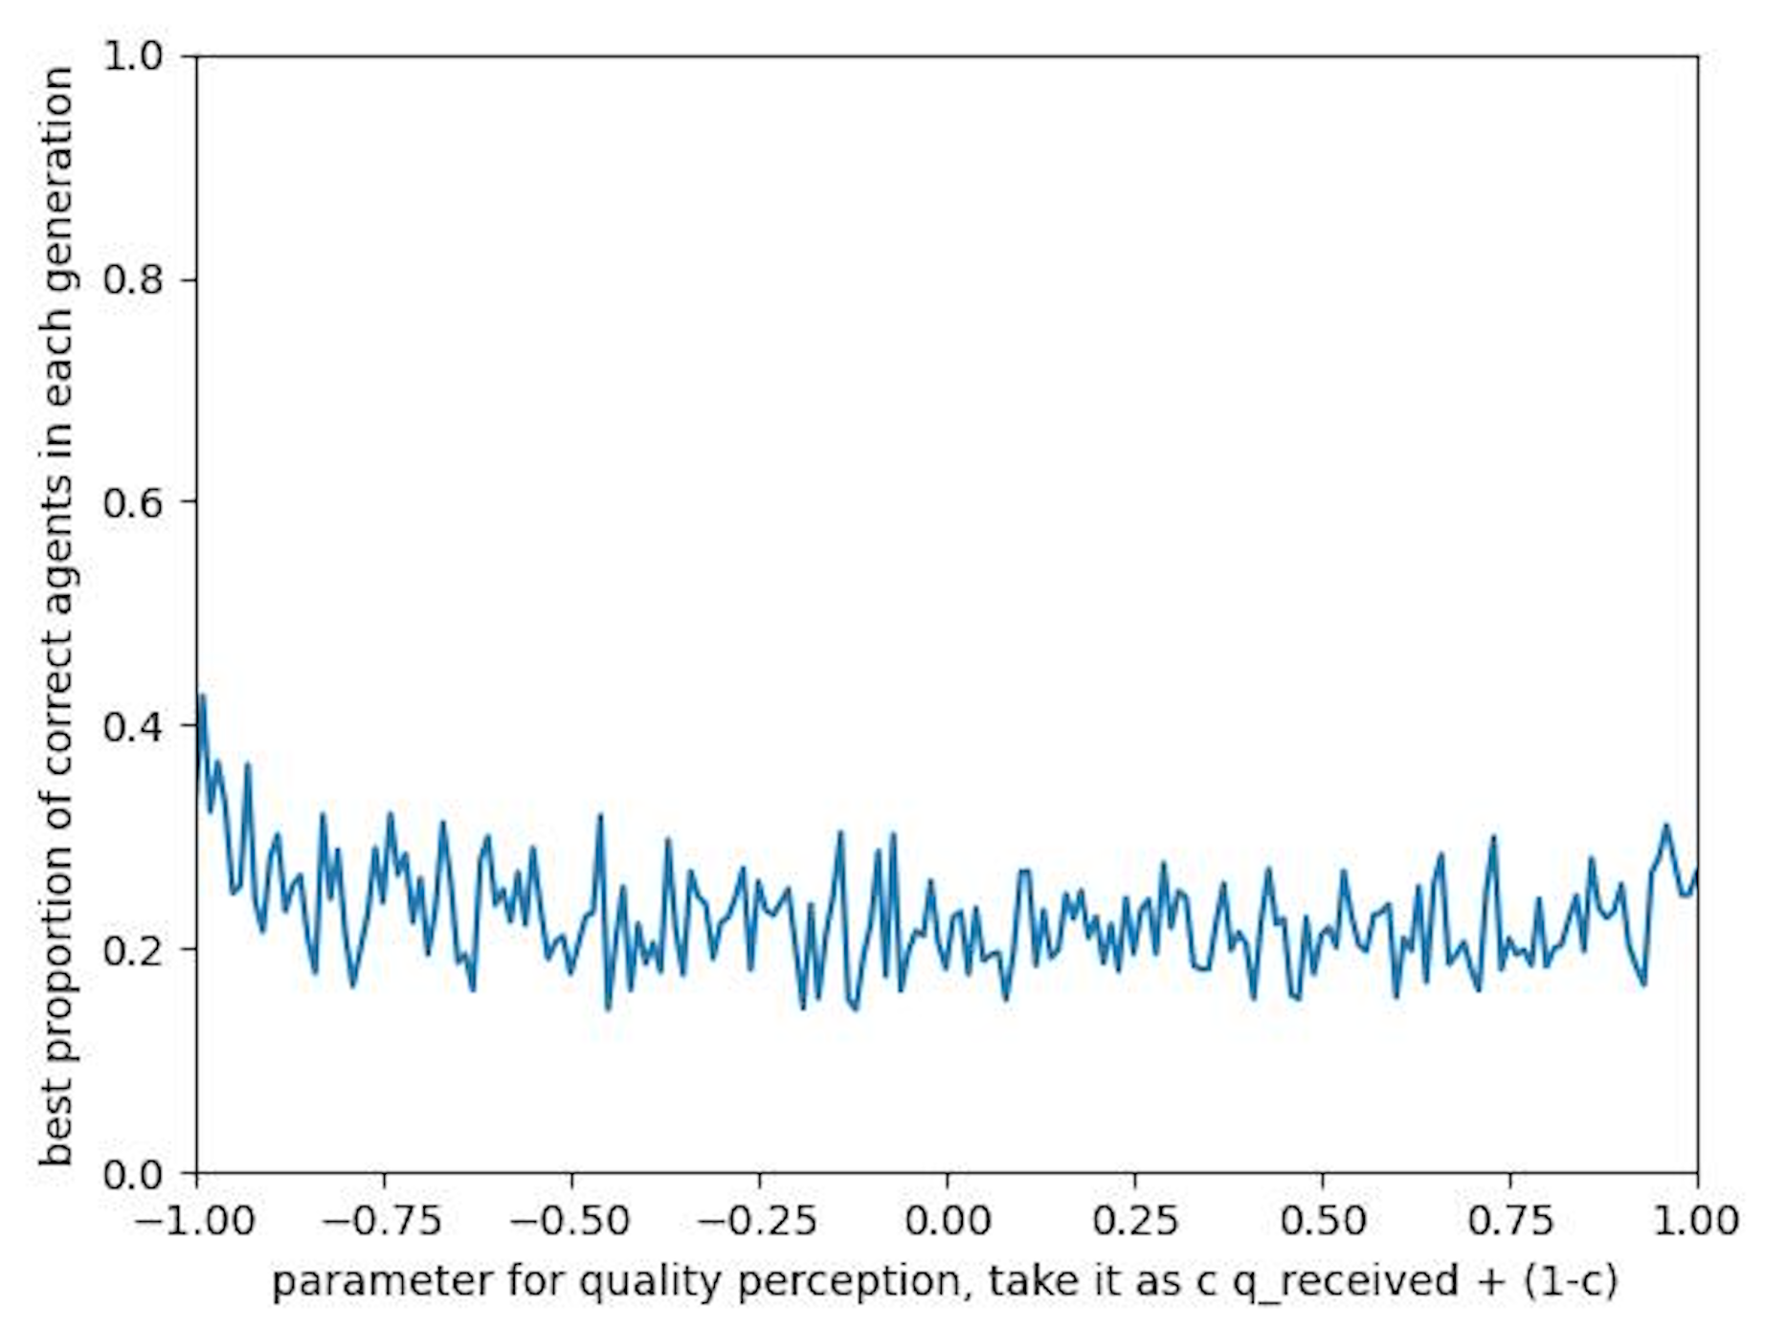
landscape
5 faulty ones out of 15
Each run repeated 30 times
Took the avg of the last 50 timestep of each run
There is some curvature but not super obvious

Slide 12
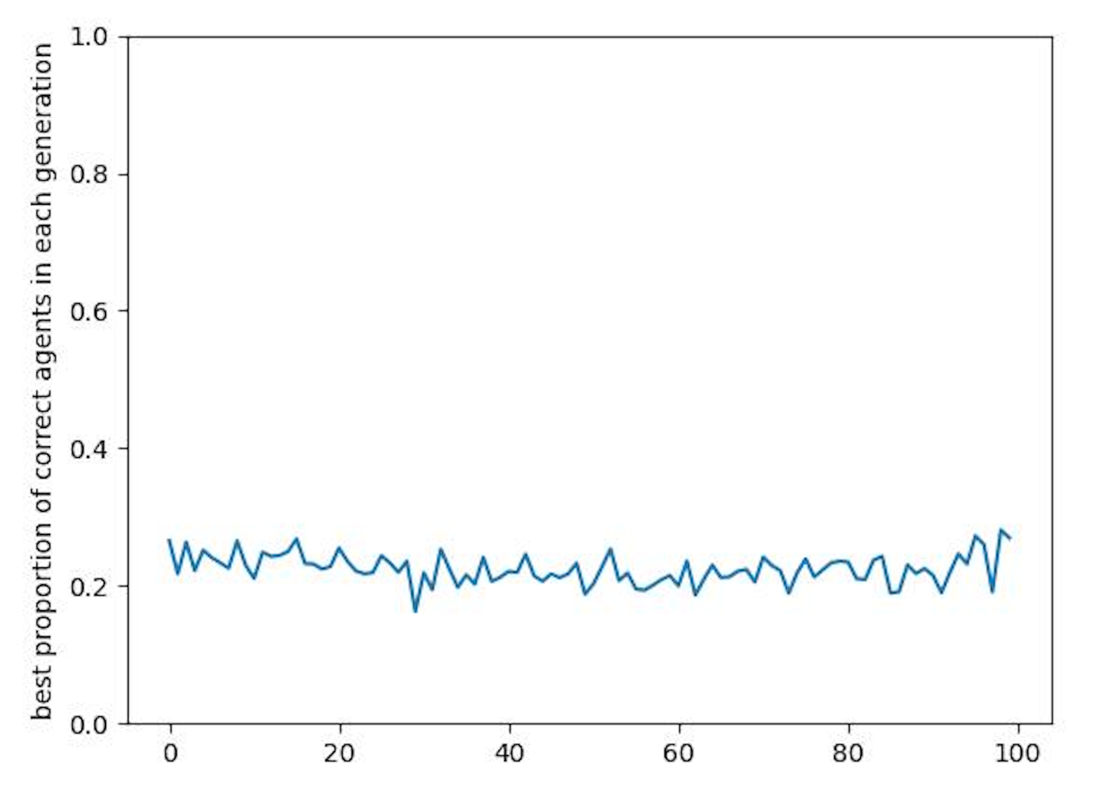
Over 100 generations well-mixed

Slide 13
Reduce the randomness (more deterministic)
Deterministic initialization
See if x-y works
Make sure u have a valley
One-to-one mapping of quorum sensing and finding best of n
Communication cost

Slide 14
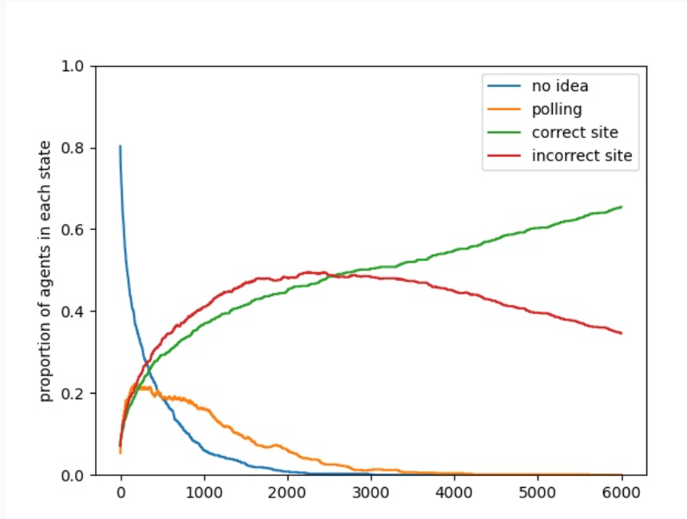
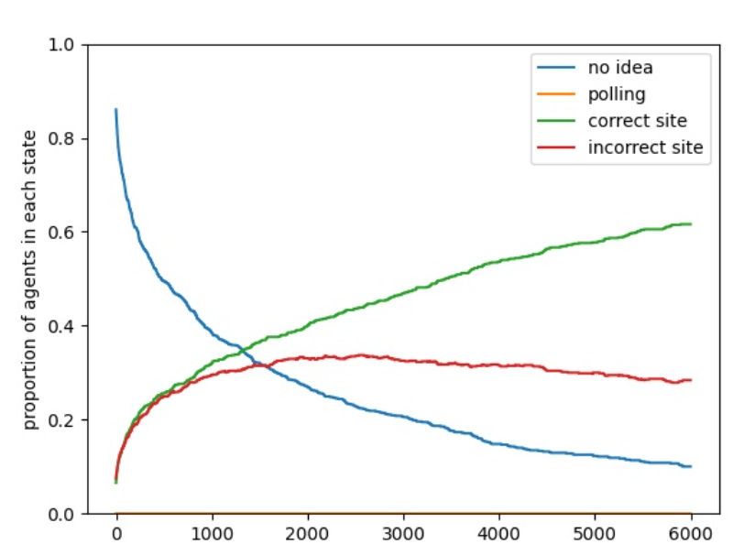
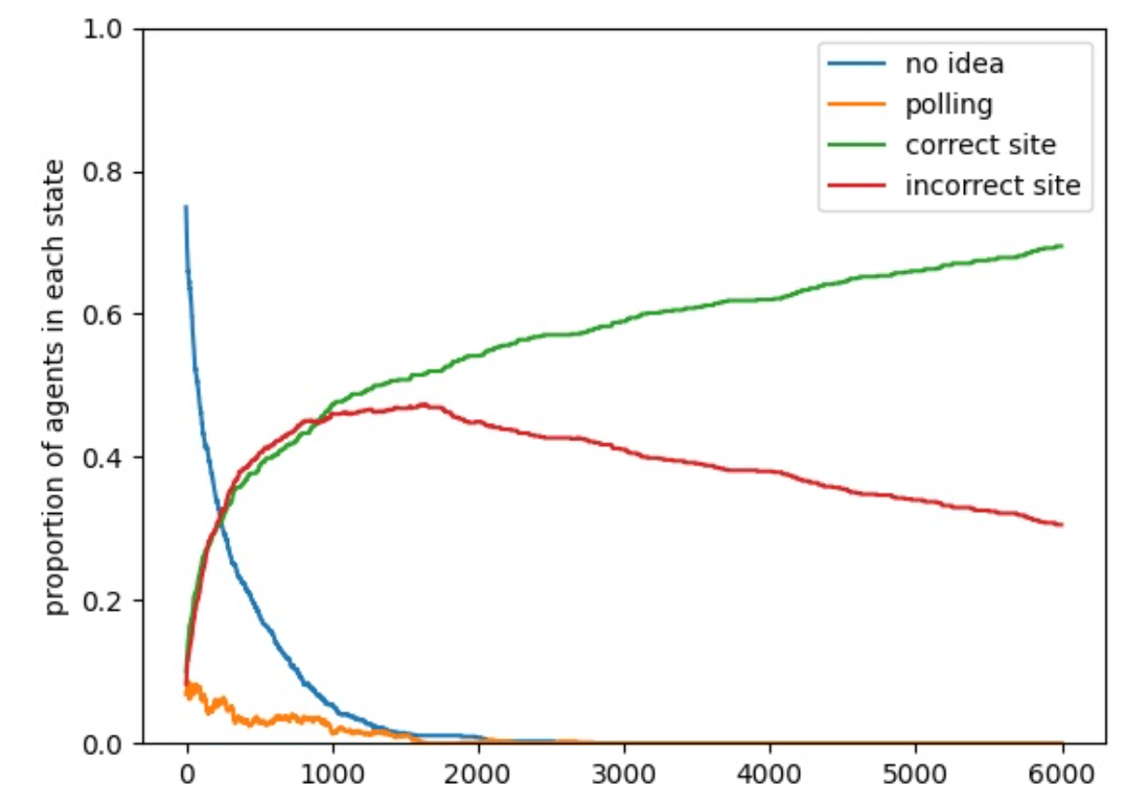
s1r1
s2r1/s1r2
s2r2

Slide 15
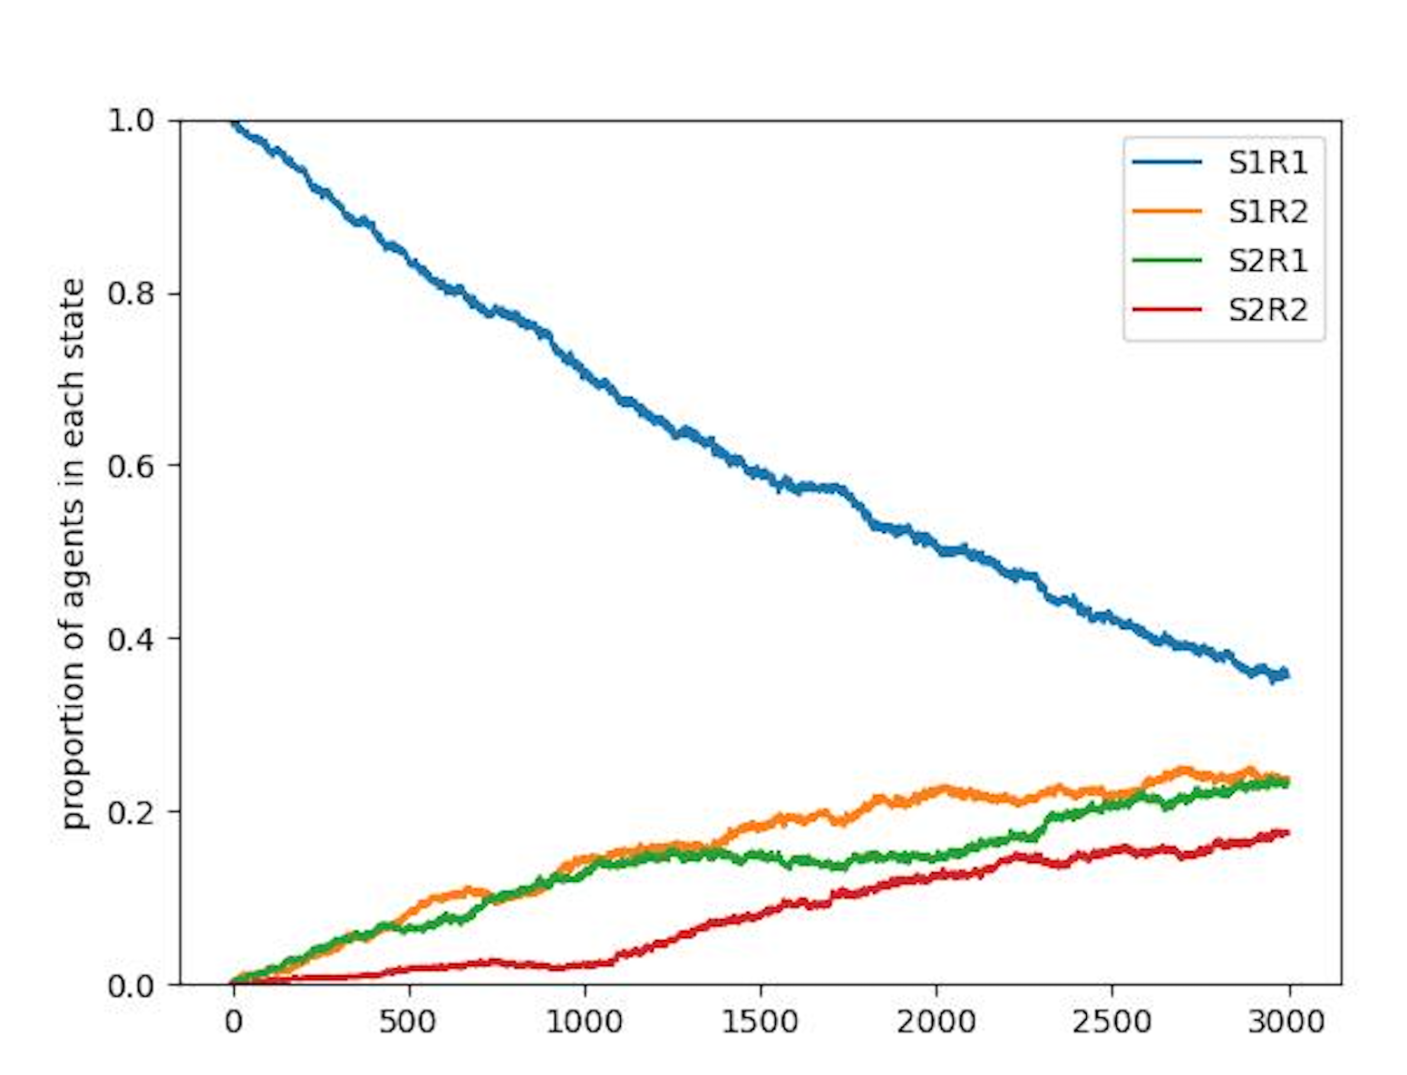
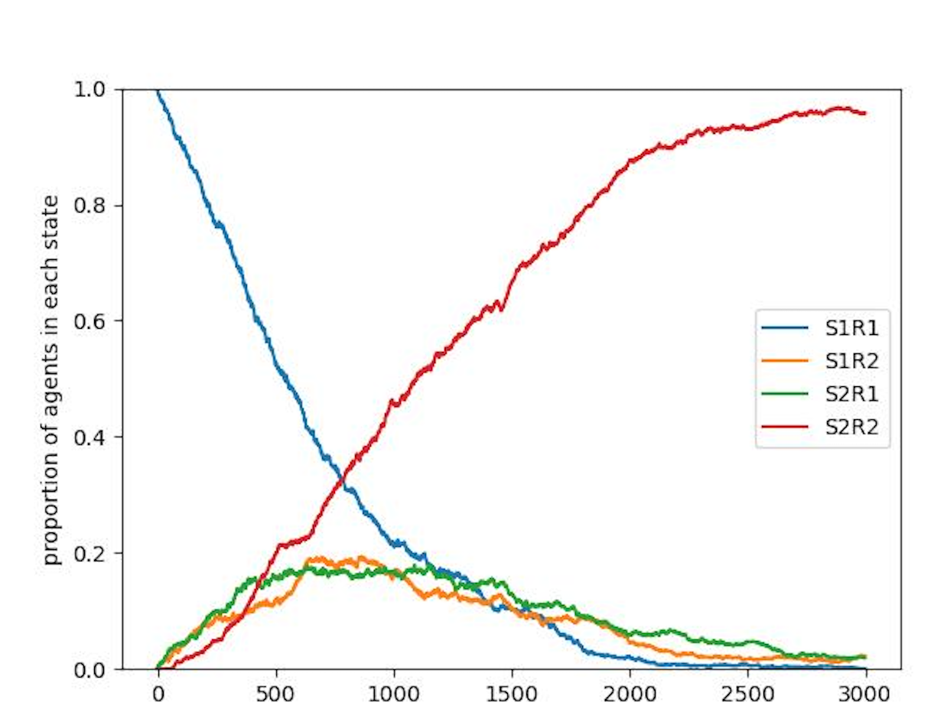
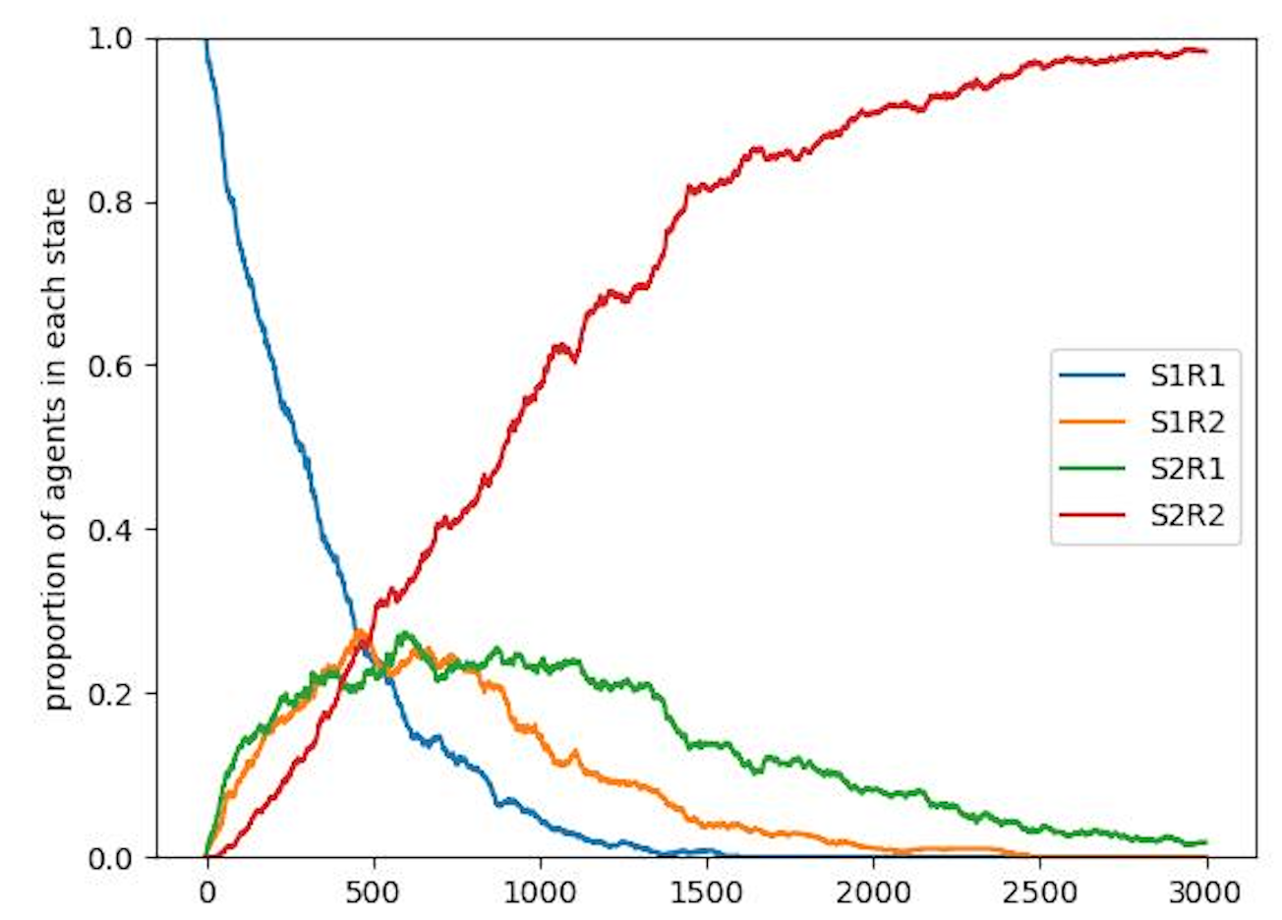
Star
Wellmixed
Ring

Slide 16
Don’t take avg over runs
Plot p_fx
Invasion model -> start with one single mutant and fixation probability
Make r1 and r2 the same and mutation towards r2
Check game
Check evolution
Make it less likely for agents to go there by chance

Slide 17
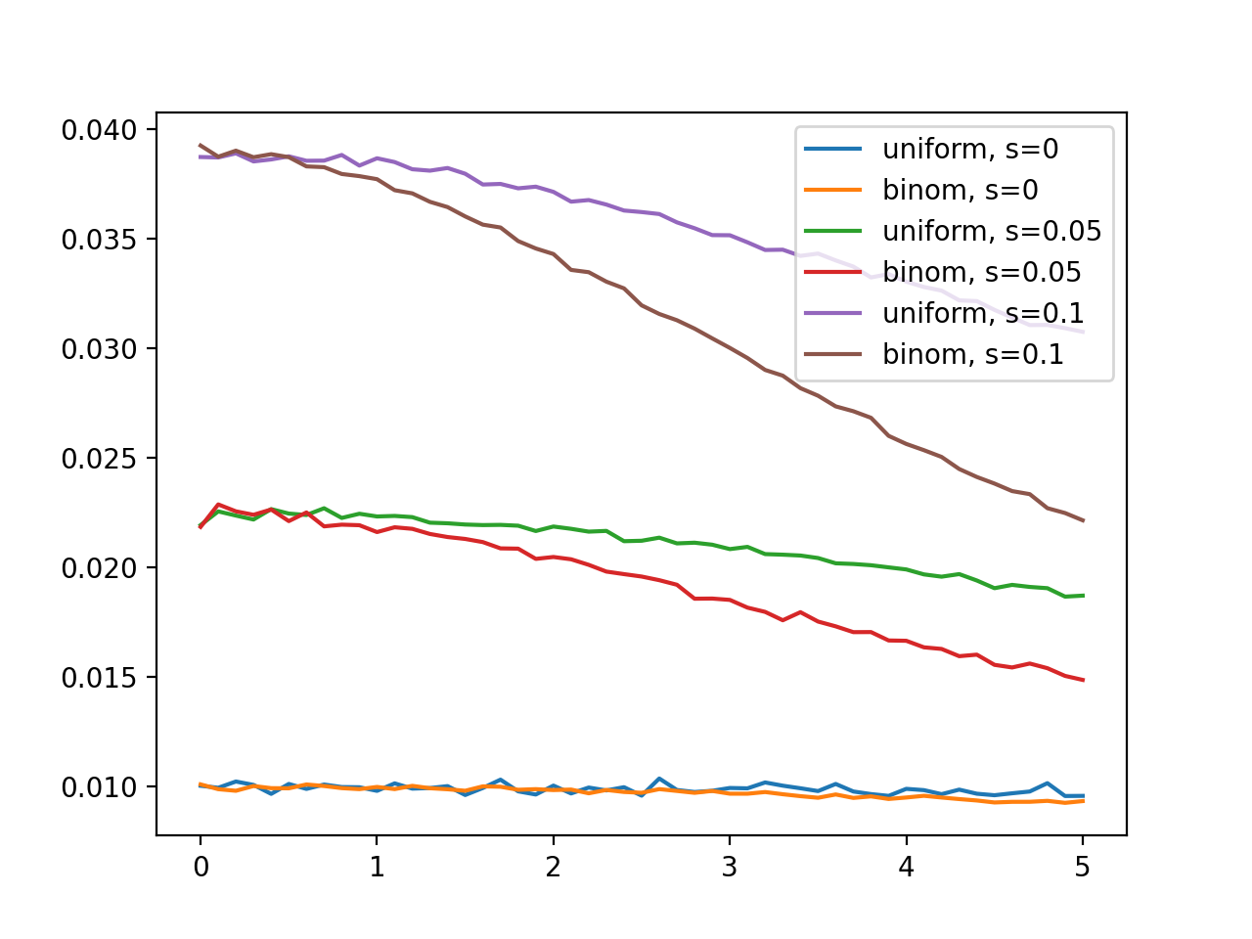

Slide 18
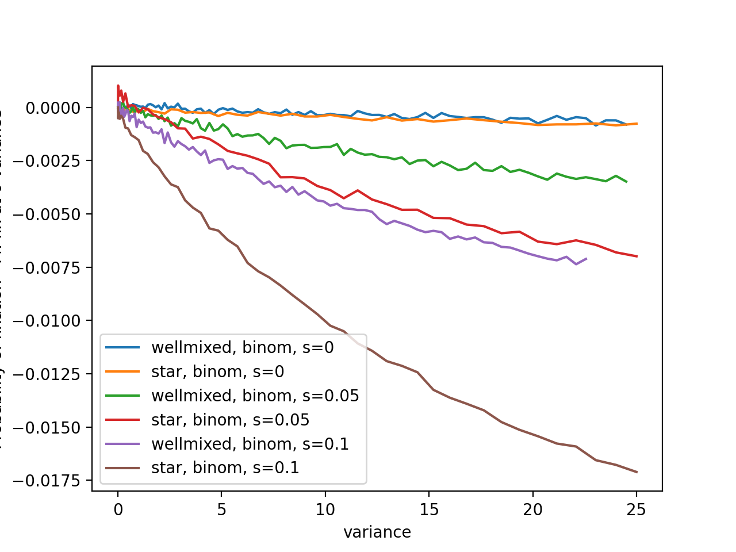

Slide 19
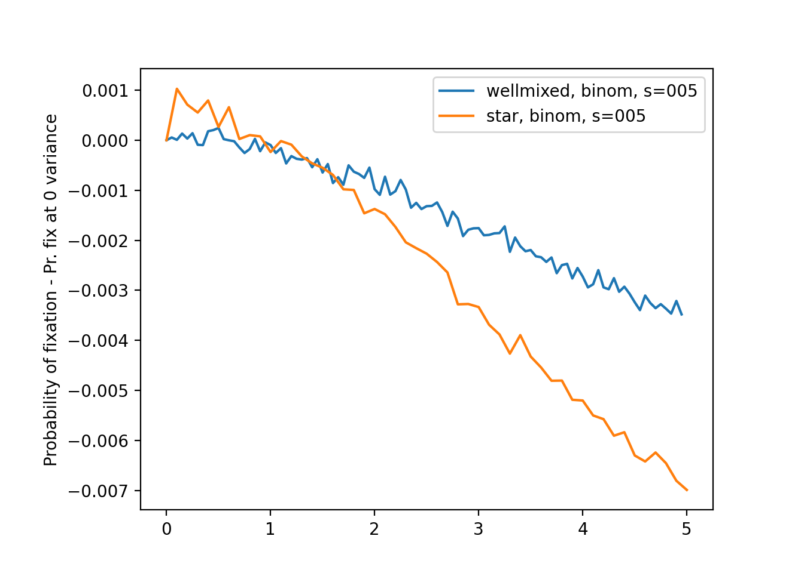
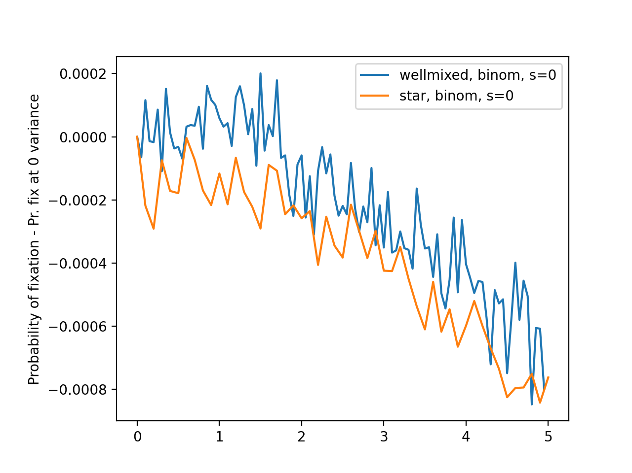
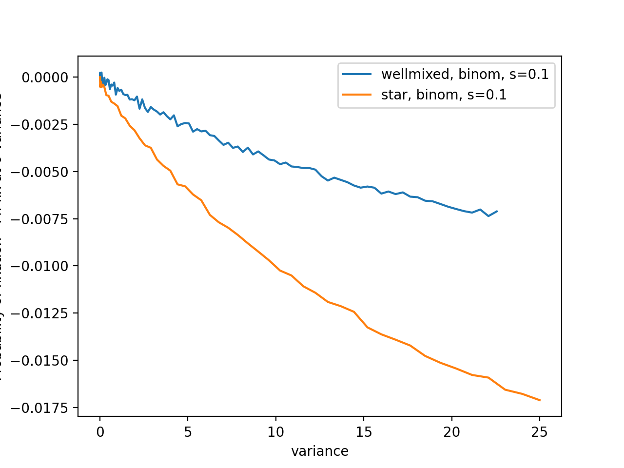

Slide 20
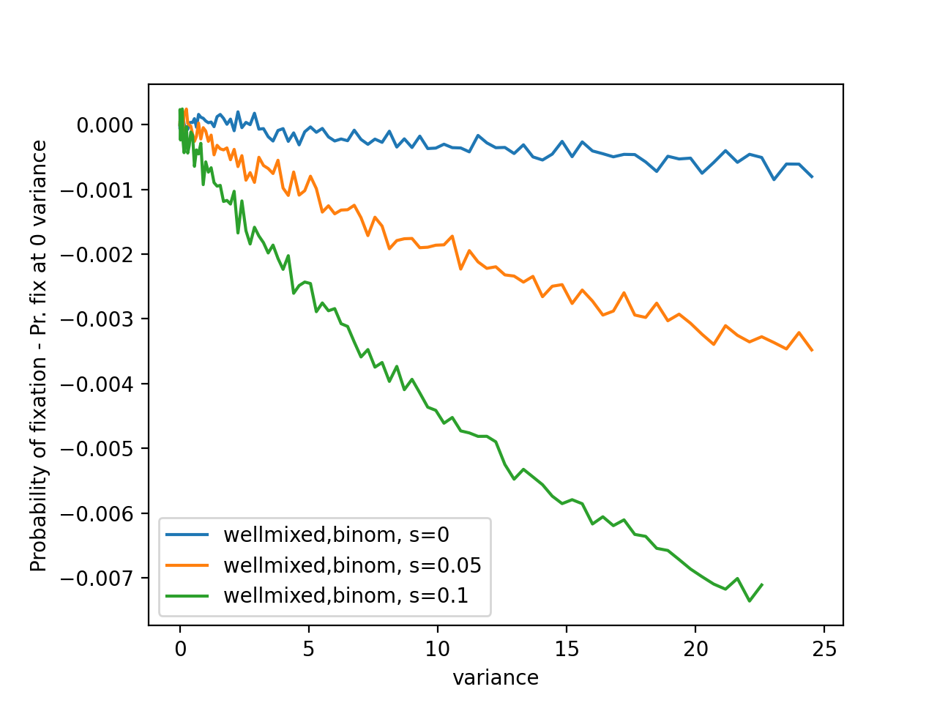
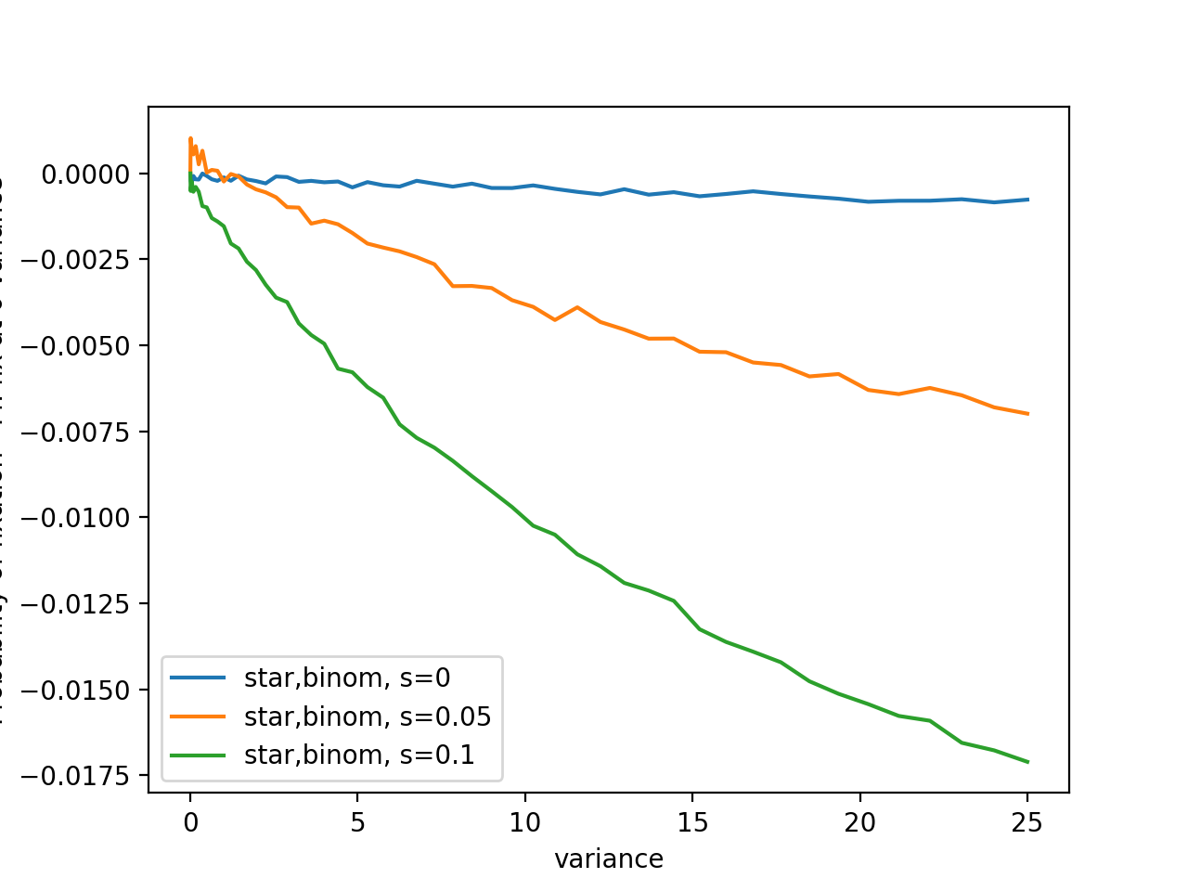

Slide 21
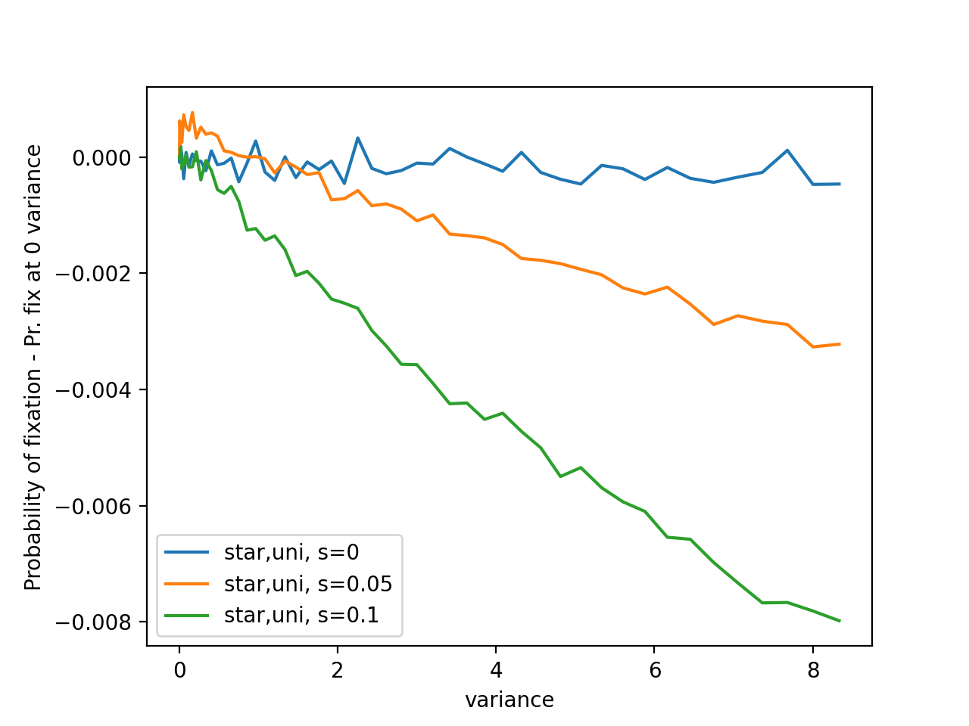

Slide 22
To-Do
Try mean not 5 (with the same existing)
Look at initial condition -> fixation (Conditional prob. Of fix given good initial)
On a run that fixed, what happen to the frequency of mutant (start on good one)
On a run that doesn’t fix, what happen to frequency of mutant
Negative s
Ask YP for suppressors for BD

Slide 23
May 6th
Run everything with mean 1
Temporal correlation
Try more s, see if everything is doubled
Do more wellmixed vs star s 0.05
Compile all the figures into a pdf and send to prof
Try some k-regular graph
Check pfix same as wellmixed
Record avg time to fixation given it fixed

Slide 24
Things we want to explore
Skewness
Spatial correlation
Correlation in time
Sample noise for every node at the start of simulation, and use it deterministically for mutant in the remaining of the simulation

Slide 25
Big picture
Temporal variance
Correlated temporal variance
Transition matrix from t to t+1 (change the 2x2 matrix so that it’s more likely to stay or more likely to change)
Fixation time
Spatial variance
Correlated spatial variance
skiew

Slide 26
May 27 meeting
presented mean 1 graphs
overall trend same
2s well mixed and s star don’t exactly align, some difference / crossing over
presented spatially correlated graphs
looking weird :D, esp star

Slide 27
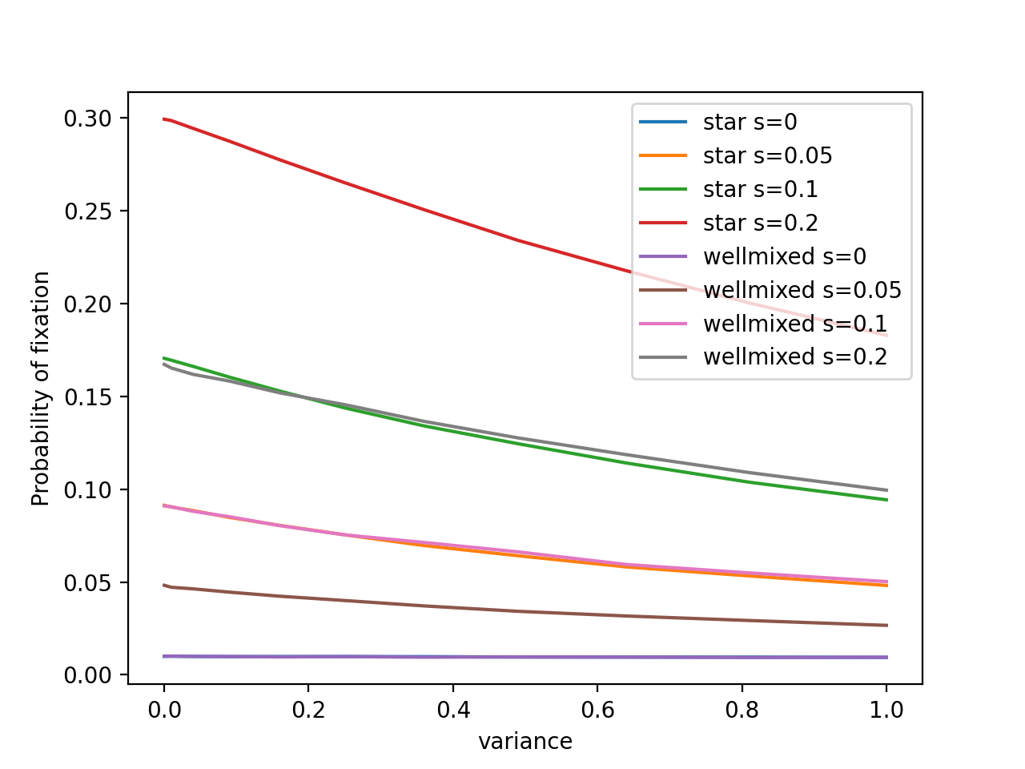
mean 1: overall trend same as before

Slide 28
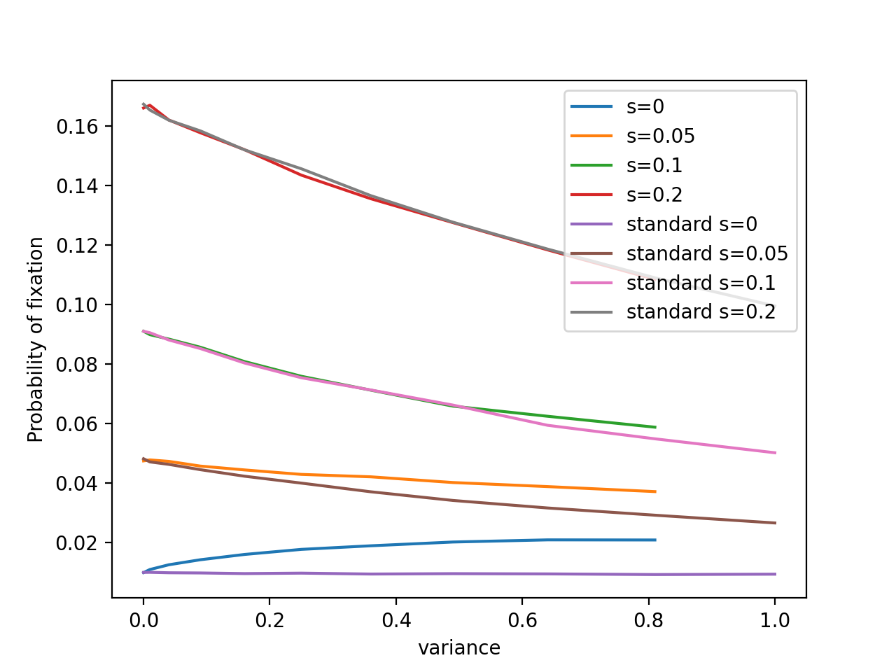
Wellmixed, spatially correlated

Slide 29
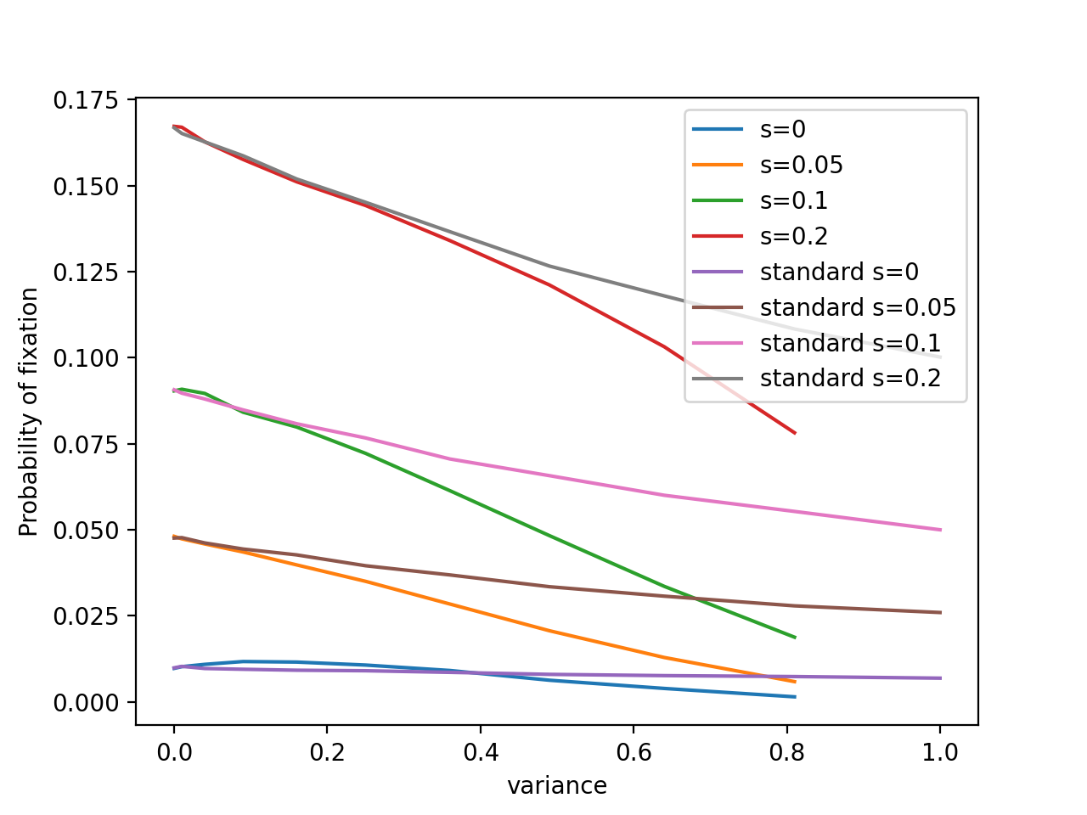
3 regular graph, spatially correlated

Slide 30
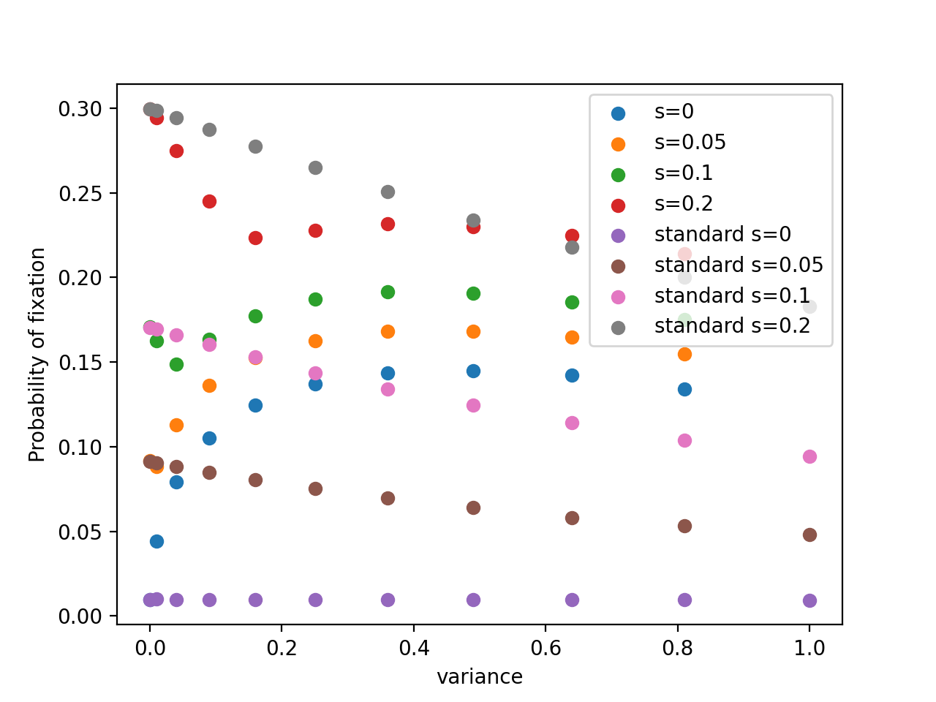
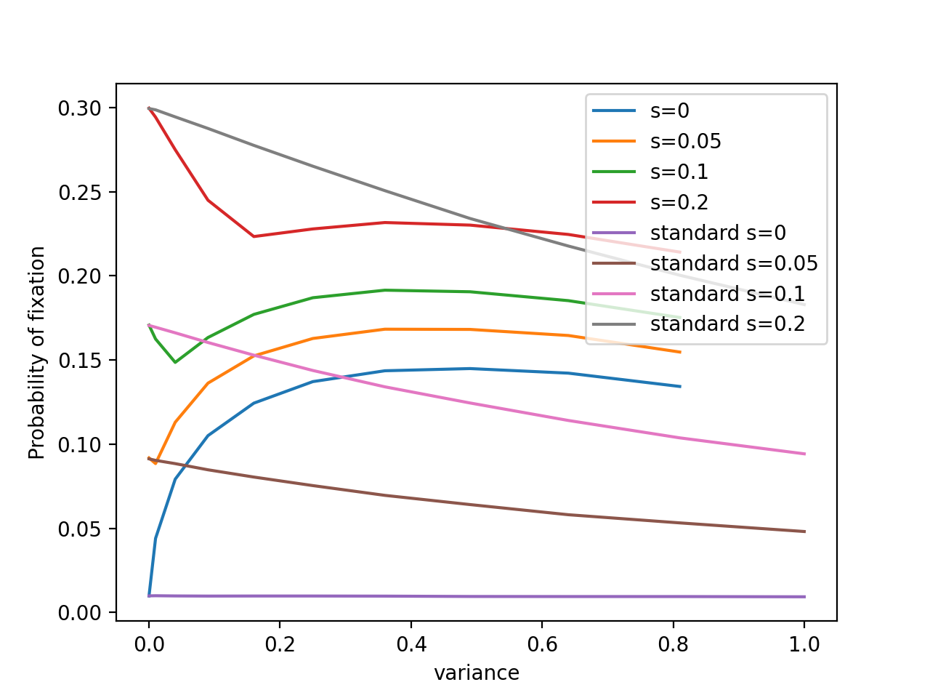
Spatially correlated star

Slide 31
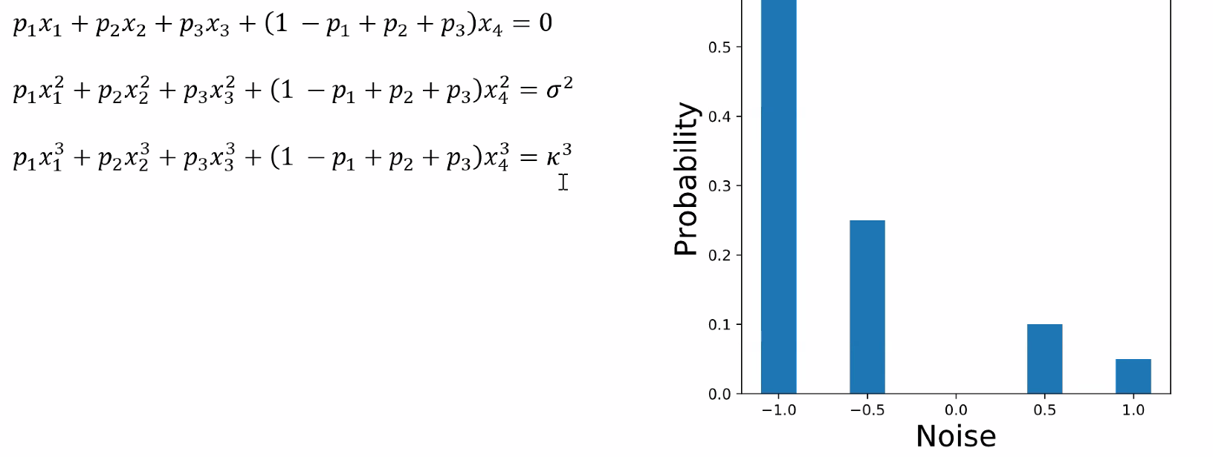
To-dos
test independent temporal w.r.t geometric mean
fix selection s = 0.1
plot p-fix no variance and p-fix max variance
do this for all a lot of graph types (maybe do 20?) need to rewrite the code a bit
skewness
use discrete -1.0 to 1.0 distribution to engineer “skew” ie. third moment
some math to do
linear system in p,
solve for mean=0, fixed var
Correlated temporal
at east b-d, some prob. p of inheriting,
some prob of mutating
search for p

Slide 32
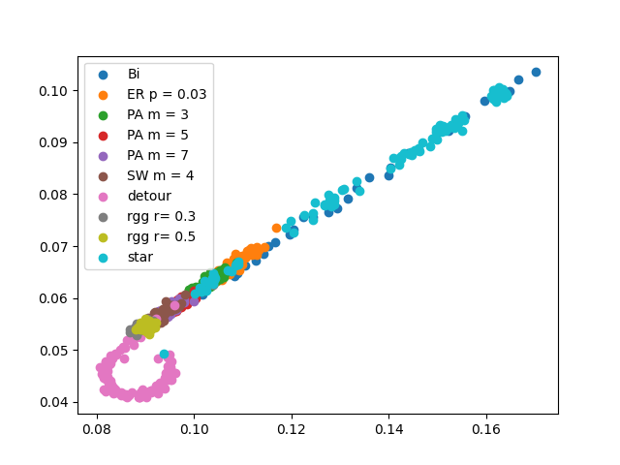
June 23 update
basic graphs
y: p-fix at max variance
x: p-fix at 0 variance

Slide 33
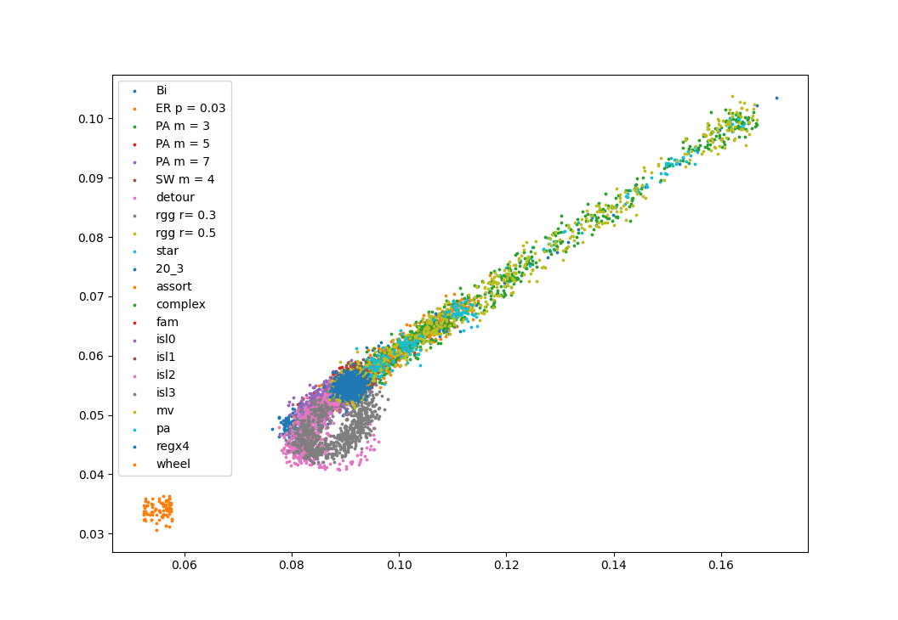
for all graphs from YP and Anush, potentially need to repeat a bit more

Slide 34
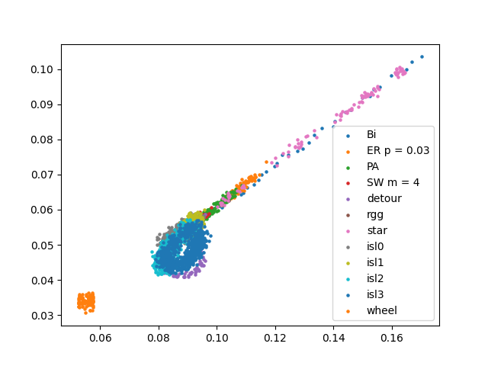
Basically the same but fewer classes of graphs,
should reduce even further

Slide 35
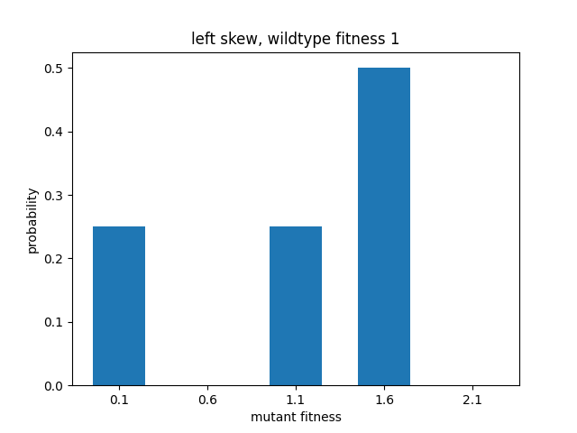
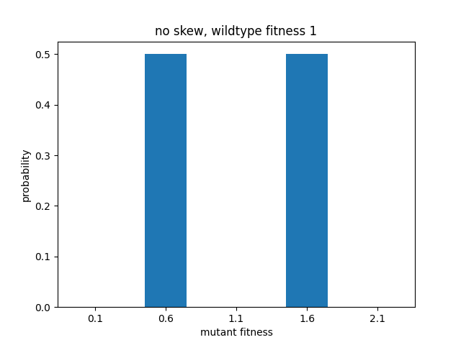
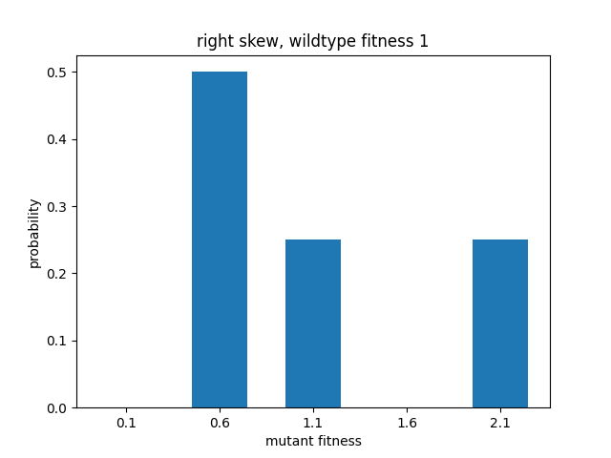
Skew

